Slide 1


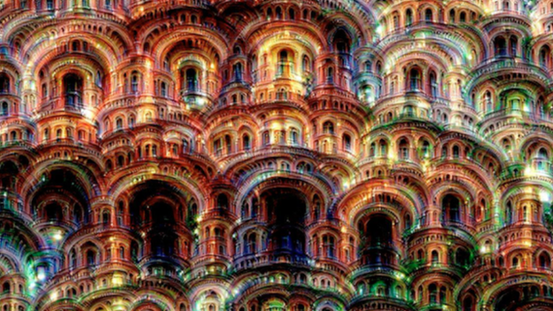


@ProlificIdea
@Entelect
ProlificIdea.com
Machine Learning – Neural Networks
Notes:
Rishal presenting in Cape Town
Rushil is helping us out on the Introductory track
Meetup line up
Presentation - Neural Network at bar area and Introductory in the board room.
Introductory track will be the same as the first presentation we gave, for those already attended can join the Neural Network talk
We will be wrapping up at around 8:30 and a quick chat about the experience

Slide 2
In The News
Facebook open sources fastText
Google AI XPrize
Notes:
Facebook open sources Fast Text (https://github.com/facebookresearch/fastText)
Extremely fast and efficient
Can train models on more than 1 billion words in less than 10 minutes using a standard multicore CPU
Focuses on classifying words and sentences
XPrize (http://ai.xprize.org/)
General AI prize where teams can compete for a chance to win $5 million
Registrations are now open

Slide 3
What is a Neural Network?
Notes:
It is a computer system modelled on our understanding of how the human brain works. Your brain consists of Neurons and they link to each other using Synapses. When a neuron receives information from other neurons it makes a decision based on the input and then passes that decision on to other neurons. This structure and interaction is what neural networks try to simulate.

Slide 4

The Neurons
Input Layer
Output Layer
Hidden Layer
Notes:
A neural network consists of three or more layers of neurons that connect to each other.
Each neuron then makes decisions or calculations based on its input and passes that on the next layer of neurons.

Slide 5
How Does it Work?
Good
Bad
Input Layer
Output Layer
Hidden Layer
Notes:
A neural network will always have an input and output layer. The input layer can be seen as the record or data that is input into the network, the output layer represents the results of the neural network. Lets assume for the rest of the talk we are creating a classification neural network. So if you are creating a classification neural network each output node will represent a label from the list available classifications.

Slide 6
How Does it Work?
Input Layer
Output Layer
Hidden Layer
Notes:
The neural network consists of a couple of hidden layers that all work together and assign various weights to the input and output nodes connecting them.

Slide 7
How Does it Work?
Good
Length
Special
Characters
Bad
Input Layer
Output Layer
Hidden Layer
Notes:
When you train your neural network it send the data through all of the nodes, and based on the training classification data increase or decrease the weights in the network so that the next time the same data is sent through more weight will be given to the correct nodes.
The nodes all talk to each other, each making a decision about a piece of the data and telling the others, eventually at the nodes at the listen to what all the other nodes said and makes a decision about what it is.
In this scenario for instance if we use password length and amount of special characters as input nodes, the neural network will send that information on to the hidden layer.

Slide 8
How Does it Work?
80%
Good
Length
Special
Characters
20%
Bad
Input Layer
Output Layer
Hidden Layer
Notes:
The hidden layer will do calculations and send that on to the output layer. The output layer will then make a prediction about the password strength based on the results from the hidden layer.

Slide 9
Why choose a Neural Network?
Notes:
Neural networks have a high tolerance for Noisy data
They are capable of classifying patterns it wasn't trained for
Can be applied to a wide variety of problems
Adaptive learning – An ability to learn how to do tasks based on the data given for training or initial experience
Self-Organisation - Can create its own organisation or representation of the information it receives during learning time

Slide 10
Back propagation
Notes:
One of the most popular neural network algorithm
Works by sending the data through the network and then propagating the errors back through the network to adjust the weights
There are countless more and alterations to the Back Propagation algorithm but the basic concept remains the same

Slide 11
The Hidden Layers
Notes:
Neural networks usually have at least one hidden layer
The number of layers and the number of processing elements per layer are important decisions.
Some studies have been done to indicate that 5 layers (input, output and 3 hidden) should be enough to cover most complexities but that can differ a lot based on requirements

Slide 12
Some basic rules to follow
Notes:
When creating Neural Networks there are some good guideline to follow

Slide 13
More nodes per hidden layer as complexity between relationship of input and output layers increase
Notes:
As the complexity in the relationship between the input data and the desired output increases, the number of the processing elements in the hidden layer should also increase

Slide 14
First see if the processing of data can be separated into multiple stages before adding more hidden layers
Notes:
If the process being modelled is separable into multiple stages, then additional hidden layer(s) may be required. If the process is not separable into stages, then additional layers may simply enable memorization of the training set, and not a true general solution effective with other data.

Slide 15
The amount of training data sets an upper bound for nodes in hidden layer(s)
Notes:
The amount of training data available sets an upper bound for the number of processing elements in the hidden layer(s).
To calculate this upper bound, use the number of cases in the training data set and divide that number by the sum of the number of nodes in the input and output layers in the network. Then divide that result again by a scaling factor between five and ten. Larger scaling factors are used for relatively less noisy data. If you use too many artificial neurons the training set will be memorized. If that happens, generalization of the data will not occur, making the network useless on new data sets

Slide 16
Tensor Flow
Notes:
Tensor flow is an open source machine learning library from Google
Can run on multiple CPU's and GPU's
We will be using tensor flow for some of our meet ups in the future so go have a look at the getting started guide
Quick tensor flow playground demo (http://playground.tensorflow.org/)

Slide 17
Hackathon
Notes:
Same wine data set as last time
Try to classify the wine
The scikit learn Multi-Layer Perceptron can be used (http://scikit-learn.org/dev/modules/neural_networks_supervised.html#classification)

Slide 18
We are on the edge of change comparable to the rise of human life on Earth.
- Vernor Vinge

Slide 19
@ProlificIdea
@Entelect
ProlificIdea.com
Artificial Intelligence Meetup

